Slide 1
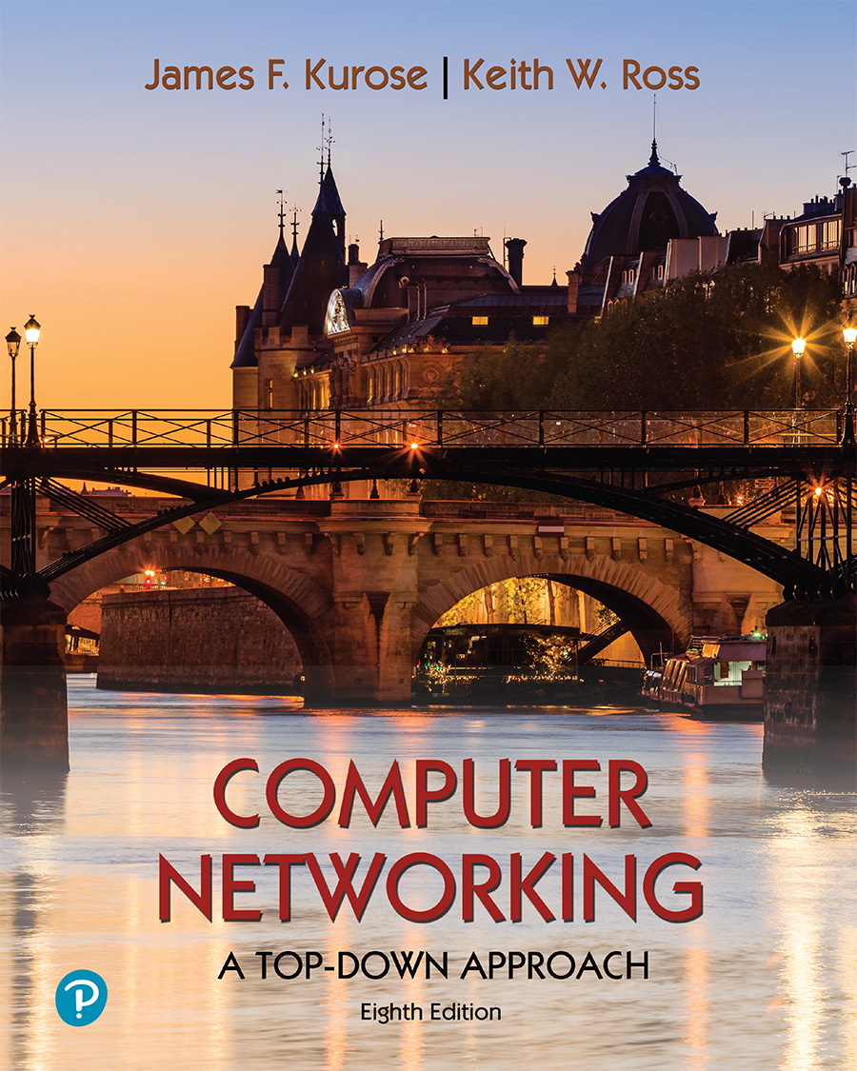
Chapter 5 Network Layer:
Control Plane
Computer Networking: A Top-Down Approach 8th edition Jim Kurose, Keith Ross Pearson, 2020
Acknowledgement: Based on the textbook’s website: https://gaia.cs.umass.edu/kurose_ross/index.php
Notes:
Version History
8.0 (May 2020)
All slides reformatted for 16:9 aspect ratio
All slides updated to 8th edition material
Use of Calibri font, rather that Gill Sans MT
Add LOTS more animation throughout
lighter header font
Re-do of network management slides; redo of Bellman-Ford slides
8.2 (changes over 8.0)
improved animations of Dijkstra’s algorithm and Bellman Ford
various improvements to BGP
SDN: added Google Orion (2021 Google network SDN control plane)

Slide 2

Network layer: “control plane” roadmap
introduction
routing protocols
intra-ISP routing: OSPF
routing among ISPs: BGP
SDN control plane
Internet Control Message Protocol
network management, configuration
SNMP
NETCONF/YANG

Slide 3
Software defined networking (SDN)
Internet network layer: historically implemented via distributed, per-router control approach:
monolithic router contains switching hardware, runs proprietary implementation of Internet standard protocols (IP, RIP, IS-IS, OSPF, BGP) in proprietary router OS (e.g., Cisco IOS)
different “middleboxes” for different network layer functions: firewalls, load balancers, NAT boxes, ..
~2005: renewed interest in rethinking network control plane

Slide 4

Per-router control plane
Individual routing algorithm components in each and every router interact in the control plane to computer forwarding tables
Routing
Algorithm
control
plane
data
plane
values in arriving
packet header
0111
1
3
2

Slide 5
Software-Defined Networking (SDN) control plane
Remote controller computes, installs forwarding tables in routers
Remote Controller
control
plane
data
plane
CA
CA
CA
CA
CA
values in arriving
packet header
0111
1
3
2

Slide 6
Software defined networking (SDN)
Why a logically centralized control plane?
easier network management: avoid router misconfigurations, greater flexibility of traffic flows
table-based forwarding (recall OpenFlow API) allows “programming” routers
centralized “programming” easier: compute tables centrally and distribute
distributed “programming” more difficult: compute tables as result of distributed algorithm (protocol) implemented in each-and-every router
open (non-proprietary) implementation of control plane
foster innovation: let 1000 flowers bloom

Slide 7
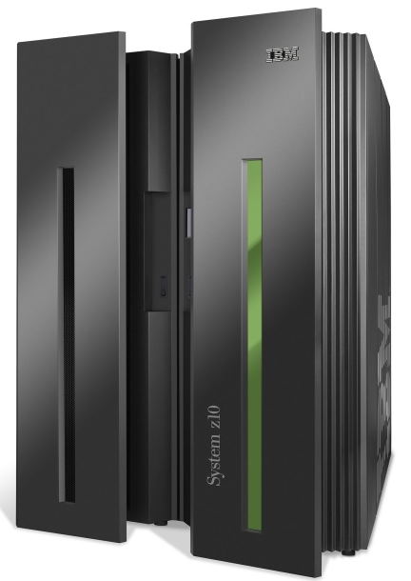




SDN analogy: mainframe to PC revolution
App
App
App
App
App
App
App
App
App
App
App
Specialized
Applications
Open Interface
Specialized
Operating
System
or
or
Windows
Linux
MAC OS
Specialized
Hardware
Open Interface
Microprocessor
Vertically integrated
Closed, proprietary
Slow innovation
Small industry
Horizontal
Open interfaces
Rapid innovation
Huge industry
* Slide courtesy: N. McKeown

Slide 8

Traffic engineering: difficult with traditional routing
5
3
v
w
5
2
u
2
1
z
3
1
2
x
y
1
Q: what if network operator wants u-to-z traffic to flow along uvwz, rather than uxyz?
A: need to re-define link weights so traffic routing algorithm computes routes accordingly (or need a new routing algorithm)!
link weights are only control “knobs”: not much control!

Slide 9
Traffic engineering: difficult with traditional routing
5
3
v
w
5
2
u
2
1
z
3
1
2
x
y
1
Q: what if network operator wants to split u-to-z traffic along uvwz and uxyz (load balancing)?
A: can’t do it (or need a new routing algorithm)

Slide 10
Traffic engineering: difficult with traditional routing
5
3
v
w
5
2
u
2
1
z
3
1
2
x
y
1
Q: what if w wants to route blue and red traffic differently from w to z?
A: can’t do it (with destination-based forwarding, and LS, DV routing)
We learned in Chapter 4 that generalized forwarding and SDN can be used to achieve any routing desired

Slide 11
Software defined networking (SDN)
…
3. control plane functions external to data-plane switches
4. programmable control applications
routing
access control
load
balance
Remote Controller
control
plane
data
plane
CA
2. control, data plane separation
CA
CA
CA
CA
1: generalized “flow-based” forwarding (e.g., OpenFlow)

Slide 12
Software defined networking (SDN)
Data-plane switches:
fast, simple, commodity switches implementing generalized data-plane forwarding (Section 4.4) in hardware
flow (forwarding) table computed, installed under controller supervision
API for table-based switch control (e.g., OpenFlow)
defines what is controllable, what is not
protocol for communicating with controller (e.g., OpenFlow)
network-control applications
…
routing
access
control
load
balance
control
plane
northbound API
SDN Controller
(network operating system)
southbound API
data
plane
SDN-controlled switches

Slide 13
Software defined networking (SDN)
SDN controller (network OS):
maintain network state information
interacts with network control applications “above” via northbound API
interacts with network switches “below” via southbound API
implemented as distributed system for performance, scalability, fault-tolerance, robustness
network-control applications
…
routing
access
control
load
balance
control
plane
northbound API
SDN Controller
(network operating system)
southbound API
data
plane
SDN-controlled switches

Slide 14
Software defined networking (SDN)
network-control apps:
“brains” of control: implement control functions using lower-level services, API provided by SDN controller
unbundled: can be provided by 3rd party: distinct from routing vendor, or SDN controller
network-control applications
…
routing
access
control
load
balance
control
plane
northbound API
SDN Controller
(network operating system)
southbound API
data
plane
SDN-controlled switches

Slide 15
Components of SDN controller
routing
access
control
load
balance
interface layer to network control apps: abstractions API
Interface, abstractions for network control apps
…
network graph
RESTful
API
intent
…
network-wide state management : state of networks links, switches, services: a distributed database
statistics
flow tables
SDN
controller
Network-wide distributed, robust state management
…
Link-state info
host info
switch info
…
communication: communicate between SDN controller and controlled switches
OpenFlow
SNMP
Communication to/from controlled devices

Slide 16

OpenFlow protocol
operates between controller, switch
TCP used to exchange messages
optional encryption
three classes of OpenFlow messages:
controller-to-switch
asynchronous (switch to controller)
symmetric (misc.)
distinct from OpenFlow API
API used to specify generalized forwarding actions
OpenFlow Controller

Slide 17
OpenFlow: controller-to-switch messages
Key controller-to-switch messages
features: controller queries switch features, switch replies
configure: controller queries/sets switch configuration parameters
modify-state: add, delete, modify flow entries in the OpenFlow tables
packet-out: controller can send this packet out of specific switch port
OpenFlow Controller

Slide 18
OpenFlow: switch-to-controller messages
Key switch-to-controller messages
packet-in: transfer packet (and its control) to controller. See packet-out message from controller
flow-removed: flow table entry deleted at switch
port status: inform controller of a change on a port.
OpenFlow Controller
Fortunately, network operators don’t “program” switches by creating/sending OpenFlow messages directly. Instead use higher-level abstraction at controller

Slide 19
SDN: control/data plane interaction example
Dijkstra’s link-state
routing
1
S1, experiencing link failure uses OpenFlow port status message to notify controller
4
…
network graph
RESTful
API
intent
3
…
2
SDN controller receives OpenFlow message, updates link status info
statistics
flow tables
…
Link-state info
host info
switch info
3
2
Dijkstra’s routing algorithm application has previously registered to be called when ever link status changes. It is called.
…
OpenFlow
SNMP
1
4
Dijkstra’s routing algorithm access network graph info, link state info in controller, computes new routes
s2
s1
s4
s3

Slide 20
SDN: control/data plane interaction example
Dijkstra’s link-state
routing
4
5
…
network graph
RESTful
API
intent
5
link state routing app interacts with flow-table-computation component in SDN controller, which computes new flow tables needed
3
…
statistics
flow tables
…
Link-state info
host info
switch info
2
…
OpenFlow
SNMP
6
controller uses OpenFlow to install new tables in switches that need updating
1
6
s2
s1
s4
s3

Slide 21
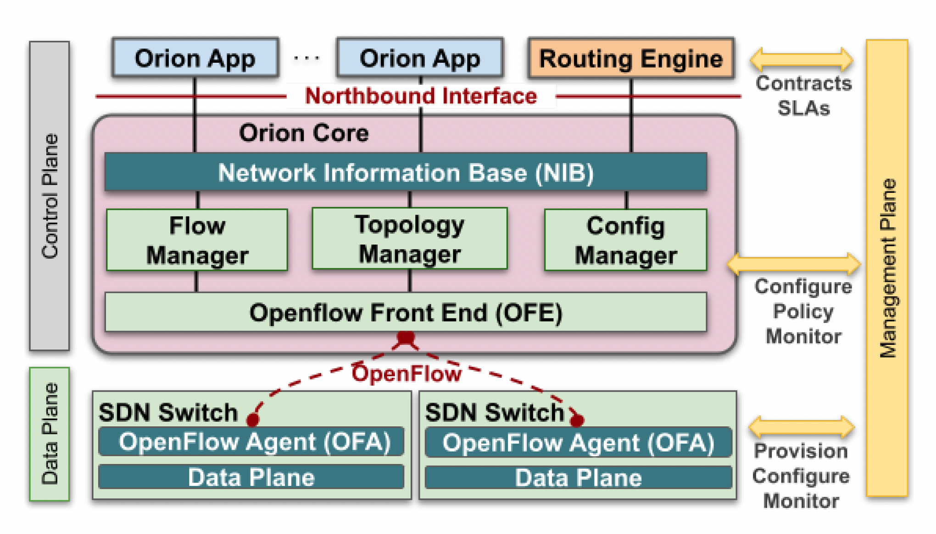
Google ORION SDN control plane
ORION: Google’s SDN control plane (NSDI’21): control plane for Google’s datacenter (Jupiter) and wide area (B4) networks
routing (intradomain, iBGP), traffic engineering: implemented in applications on top of ORION core
edge-edge flow-based controls (e.g., CoFlow scheduling) to meet contract SLAs
management: pub-sub distributed microservices in Orion core, OpenFlow for switch signaling/monitoring
Orion SDN architecture and core apps
Note: ORION provides intradomain services within Google’s network
Notes:
and so in this sense a migration away from “protocols” is indeed underway!
Explain structure of Orion in figure
Repeat after each reveal: no protocol
Coflows: “a collection of flows between two groups of machines with associated semantics and a collective objective”; [Sigcomm’13, Sigcomm’15, Sigcomm’18]. Not unlike multiprocessor scheduling in the 1980’s

Slide 22
OpenDaylight (ODL) controller
Traffic Engineering
…
Firewalling
Load Balancing
Network Orchestrations and Applications
Northbound API
REST/RESTCONF/NETCONF APIs
Enhanced Services
Basic Network Functions
…
Topology
processing
Switch
mgr.
Stats
mgr.
AAA
…
Forwarding rules mgr.
Host
Tracker
Service Abstraction Layer:
interconnects internal, external applications and services
config. and operational data store
messaging
Service Abstraction Layer (SAL)
…
Southbound API
OpenFlow
NETCONF
SNMP
OVSDB

Slide 23
ONOS controller
Traffic Engineering
…
Firewalling
Load Balancing
Network Applications
Northbound API
control apps separate from controller
intent framework: high-level specification of service: what rather than how
considerable emphasis on distributed core: service reliability, replication performance scaling
REST API
Intent
northbound abstractions,
protocols
hosts
paths
flow rules
topology
ONOS
distributed core
devices
links
statistics
device
link
host
flow
packet
southbound abstractions,
protocols
OpenFlow
Netconf
OVSDB
Southbound API

Slide 24
SDN: selected challenges
hardening the control plane: dependable, reliable, performance-scalable, secure distributed system
robustness to failures: leverage strong theory of reliable distributed system for control plane
dependability, security: “baked in” from day one?
networks, protocols meeting mission-specific requirements
e.g., real-time, ultra-reliable, ultra-secure
Internet-scaling: beyond a single AS
SDN critical in 5G cellular networks

Slide 25

SDN and the future of traditional network protocols
SDN-computed versus router-computer forwarding tables:
just one example of logically-centralized-computed versus protocol computed
one could imagine SDN-computed congestion control:
controller sets sender rates based on router-reported (to controller) congestion levels
How will implementation of network functionality (SDN versus protocols) evolve?

Slide 26
Network layer: “control plane” roadmap
introduction
routing protocols
intra-ISP routing: OSPF
routing among ISPs: BGP
SDN control plane
Internet Control Message Protocol
network management, configuration
SNMP
NETCONF/YANG

Slide 27
ICMP: internet control message protocol
used by hosts and routers to communicate network-level information
error reporting: unreachable host, network, port, protocol
echo request/reply (used by ping)
network-layer “above” IP:
ICMP messages carried in IP datagrams
ICMP message: type, code plus first 8 bytes of IP datagram causing error
Type Code description
0 0 echo reply (ping)
3 0 dest. network unreachable
3 1 dest host unreachable
3 2 dest protocol unreachable
3 3 dest port unreachable
3 6 dest network unknown
3 7 dest host unknown
4 0 source quench (congestion
control - not used)
8 0 echo request (ping)
9 0 route advertisement
10 0 router discovery
11 0 TTL expired
12 0 bad IP header

Slide 28

Traceroute and ICMP
3 probes
3 probes
3 probes
source sends sets of UDP segments to destination
1st set has TTL =1, 2nd set has TTL=2, etc.
datagram in nth set arrives to nth router:
router discards datagram and sends source ICMP message (type 11, code 0)
ICMP message possibly includes name of router & IP address
stopping criteria:
UDP segment eventually arrives at destination host
destination returns ICMP “port unreachable” message (type 3, code 3)
source stops
when ICMP message arrives at source: record RTTs

